Slide 1
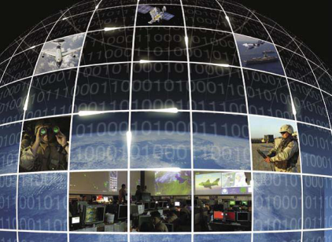
DoD Information Enterprise Architecture v2.0
Briefing for DoD Architecture Framework
(DoDAF) 2.0 Plenary
DoD CIO/Architecture and Infrastructure Directorate
January 2012

Slide 2
Agenda
DoD IEA v2.0 Purpose, Scope, and General Content
Architecture Descriptions
Reference Architecture
Use of DoDAF 2.0 and Tools

Slide 3
DoD IEA v2.0 Purpose and Scope
What is the DoD IEA v2.0?
The DoD IEA is the architecture and standards, and the organizing framework for describing the DoD desired Information Enterprise and for guiding the development of the DoD information technology capabilities
Scope
Describes the ways and means, activities, functions, and measures for achieving the IE capabilities, as well as DoD IEA/GIG 2.0 ORA convergence
Contains the DoD IE information needed for stakeholders (IT leaders, program managers, etc.) to perform their missions and tasks
Provides “line of sight” traceability
Aligns IE architecture, reference architecture, and technical architecture to the IEA 2.0 (DCSC RA, NORA, etc.)
Purpose
Describe operational environment IE must enable
Provide stakeholders with operational context needed to better understand principles and rules and how to apply them
Identify operational requirements that IE investments and solutions must address
Define capabilities required to provide the end state IE to enable Mission Area objectives
Provide basis for gap analysis in support of decision-making: identify gaps, determine investments/solutions to fill gaps, measure progress in filling gaps
Provide baseline description of IE for use in managing change and risk associated with rapidly evolving operational needs
Enable compliance measurement to assess progress towards achieving required end state
Provide a tool to assist programs and other users in identifying and navigating relevant requirements and guidance documents

Slide 4
What the DoD IEA v2.0 Contains
Content | Description
Architecture Viewpoints (AV, CV, OV, SVCV, SV, and StdV) | Represents the architecture for the Information Enterprise (IE) in a manner that enables stakeholders to focus on specific areas of interests, while retaining sight of the big picture.
IEA Compliance Criteria | Describes the information that all architectures will comply with and established the criteria for assessing architecture compliance with the IEA.
Reference Architecture (EANCS RA, ADORA, ITIORA, NORA/JEN RA, and DC&SC RA) | Provides detailed descriptions of the relevant principles, rules, patterns, technical positions, and vocabulary for a specific focus area.
Integrated Document and Executive Report | Combines all content in the DoD IEA into a coherent, integrated document and provides an executive level summary of key information and analysis.
Document Framework | A document navigation support tool that consolidates and organizes compliance and guidance documents by document type, capability type, and other categories to support compliance understanding and analysis.
EA Compliance Requirements | Describes the criteria for complying with the EA.

Slide 5
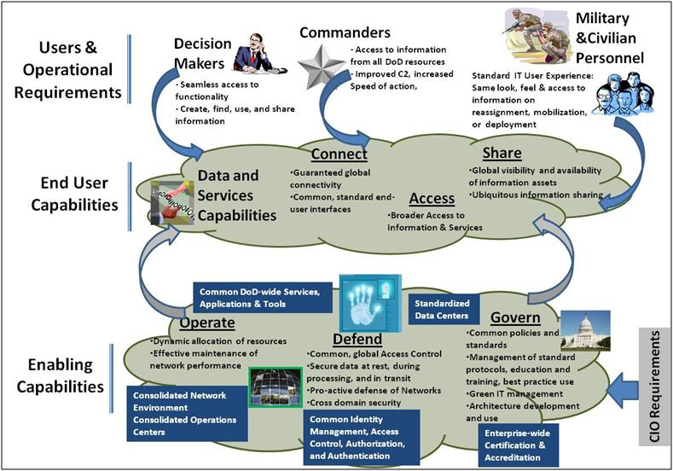
CV-1: DoD IE Vision
Users connect to, access, and share information and information assets using End User Capabilities
Enabling Capabilities to operate, defend, and govern the IE provide an infrastructure and environment that deliver End User Capabilities
End User Capabilities and Enabling Capabilities together make up the IE Capabilities

Slide 6
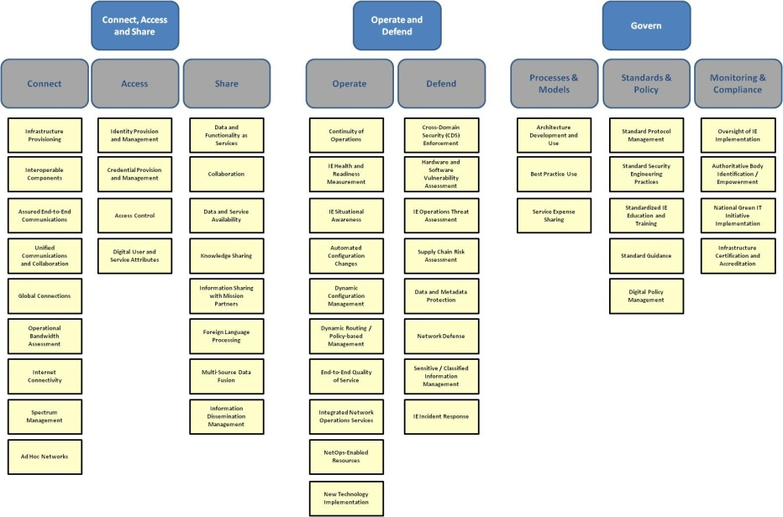
CV-2: Capability Taxonomy
The IE Capabilities are organized under three areas: Connect, Access and Share; Operate and Defend; and Govern
These are the capabilities that are needed for the IE to properly support DoD Operations

Slide 7
CV-6/7: Capability to Operational Activities/Services Mapping
Capability | Definition | Activities | Rules | Services
Connect | The set of computing and communications infrastructure capabilities enabling any user or service to reach any other user or identify and use any other service.
Infrastructure Provisioning | The ability to provision and allocate shared computing and data storage resources in a computing platform agnostic, location independent, transparent, and real-time manner. | A3.1.1.1 Provide Services Infrastructure A3.2.1.2.1.3 Enable Dynamic, Virtual Processing in Computing Infrastructure A4.2.3.1 Allocate IE Resources | CIR 01 CIR 05 CIR 06 | S1.1.6.1 Storage On Demand Services S1.1.6.2 Computing On Demand Services S1.3.6.1 Software as a Service S1.3.6.2 Infrastructure as a Service S.1.3.6.3 Platform as a Service
Unified Communications and Collaboration | The ability to seamlessly integrate voice, video, and data applications services so they are delivered ubiquitously across a secure and highly available single protocol network infrastructure. |  | CRP 01 CRR 01 | S1.1.2.1 Video over IP Services S1.1.2.2 Voice over IP Services S1.1.2.3 VPN Services
The mapping of activities and services to capabilities is provided in a single matrix
This matrix also maps relevant rules to the capabilities
This provides a complete description of each capability to include definition and mapping of relevant activities, rules, and services

Slide 8
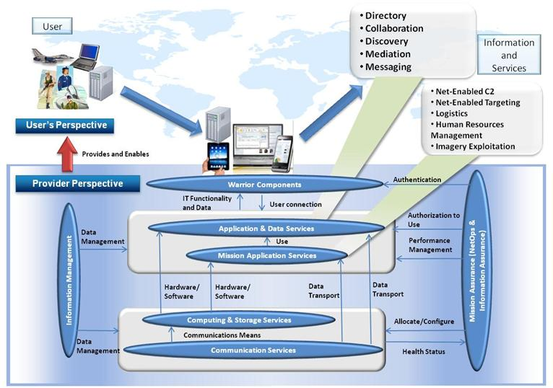
OV-1: Operational Concept for the IE

Slide 9
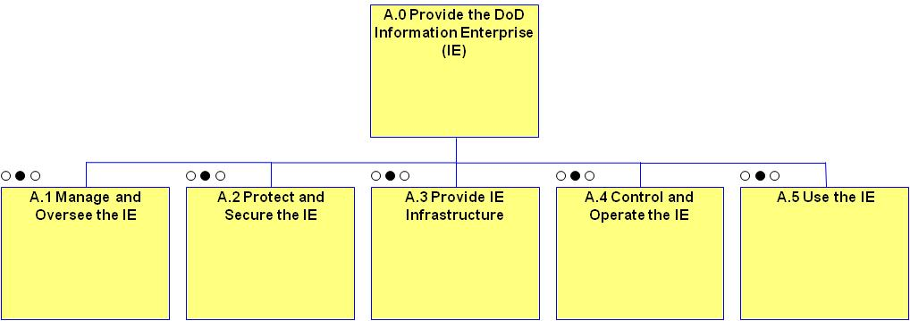
OV-5a: Operational Activity Decomposition Tree
Represents the merging of DoD IEA v1.2 and GIG 2.0 ORA activities
Each level 1 main activity is further decomposed to level 3 or lower

Slide 10
OV-6a: Operational Rules Model
OV-6a: Operational Rules Model
Communications Readiness Principle (CRP)
 | CRP 01 - The GIG communications infrastructure shall support full IP convergence of traffic (voice, video, and data) on a single network.
Communications Readiness Business Rules (CRR)
 | CRR 01 - Implement a modular, layered design based on internet protocol for the transport infrastructure.
 | CRR 02 - GIG communications systems shall provide network connectivity to end points (such as Wide and Local Area Networks and direct connections to mobile end-users) in the same or different autonomous systems.
Same Principles and Rules from DoD IEA v1.2
Operational rules derived from the GIG 2.0 ORA have been added

Slide 11
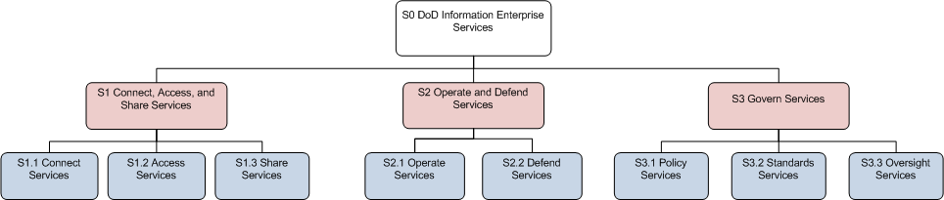
SvcV-1: Services Context Description
The Services Context Description aligns with the IE Capability structure
Level 1 services are decomposed down to level 3 or 4
An SvcV-4 Services Functionality Description is also being developed
The DoD IEA v2.0 will contain the following views: AV-1, AV-2, CV-1, CV-2, CV-6, CV-7, OV-1, OV-5a, OV-6a, SvcV-1, SvcV-4, StdV-1, and StdV-2
It will also contain an Operational Context, Document Framework, EA Compliance Requirements, and Reference Architectures

Slide 12
Enterprise-Wide Reference Architectures* Developed by DoD CIO
Reference Architecture | Brief Description | Approval Date
Enterprise-wide Access to Network & Collaboration Services RA (EANCS RA) | Guides, standardizes, and enables the implementation of authentication and authorization capabilities to access collaboration services in support of secure information sharing across the Department. | Aug 2010
Active Directory Optimization RA (ADORA) | Guides the transformation of legacy Windows networks that use AD to improve security, facilitate secure info sharing across networks, and achieve efficiencies through network consolidation. | Feb 2011
IT Infrastructure Optimization RA (ITIORA) | Leverages Defense ITIL Catalog to provide rules and standards for the optimal level (Enterprise, Theater, Installation) from which IT services are delivered. | Apr 2012 (planned)
Data Center & Server Consolidation RA (DC&SC RA) | Defines & standardizes necessary attributes for Core DoD computing Centers integrating DoD cloud and server virtualization concepts. | Apr 2012 (planned)
Network Optimization RA (NORA | Guides the implementation of joint networks using network virtualization or federation techniques and leveraging regional boundary protection (TLA) concepts. | Apr 2012 (planned)
*As defined in the June 2010 Reference Architecture Description Document
Notes:
Suggested talking points/voice track
“This is not your father’s IEA”. IEA v2.0 is ambitiously scoped to fully describe and depict the vast DoD Information Enterprise. The current IEA (v1.2) only addresses a narrow slice of the IE. The IEA will be a key enabler for Department goals of achieving must greater IE/IT efficiencies and for driving the IE toward a single, logically seamless network of networks that operates on service-centric principles.
The IEA will shape and guide the evolution of the IE so the IEA must continuously evolve to reflect changing strategic imperatives for the IE as well as new DoD Business, Warfighter, and Defense Intel requirements for the IE.
A&I is OPR for the DoD IE and IEA but we don’t exclusively “own” the content, use or governance. The IE/IEA is truly a DoD-wide resource and enabler. The IEA must reflect strategy and content from OPRs for all of the IE functional areas (e.g. C2/Transport, IA, Enterprise Service, NetOps)
We need your help. The data and content that will be required to build out the IEA exists in many places across DoD, some of it is visible and accessible, some not. We need POCs in your organizations to help us capture the data and to participate in periodic reviews of the architecture. And as your plans and strategies evolve over time we need to capture that as well. To help with this we plan to leverage an existing governance body such as the ASRG to function as a “board of directors” for the IEA

Slide 13
Other Enterprise-Wide Reference Architectures Are Under Development
Reference Architecture | Development Lead
NIPRNET Regional Security Architecture (NRSA) DoD Enterprise Security Architecture (DESA) | DISA PEO-MA/PEO-GE
DoD Biometrics Enterprise Architecture | BIMA
Command & Control On the Move RA (C2OTM RA) | Joint Staff (J8)
Joint Information Environment Operational RA (JIE ORA) | Joint Staff (J8)
Mission Secret Network RA | Joint Staff (J8)
Notes:
Suggested talking points/voice track
“This is not your father’s IEA”. IEA v2.0 is ambitiously scoped to fully describe and depict the vast DoD Information Enterprise. The current IEA (v1.2) only addresses a narrow slice of the IE. The IEA will be a key enabler for Department goals of achieving must greater IE/IT efficiencies and for driving the IE toward a single, logically seamless network of networks that operates on service-centric principles.
The IEA will shape and guide the evolution of the IE so the IEA must continuously evolve to reflect changing strategic imperatives for the IE as well as new DoD Business, Warfighter, and Defense Intel requirements for the IE.
A&I is OPR for the DoD IE and IEA but we don’t exclusively “own” the content, use or governance. The IE/IEA is truly a DoD-wide resource and enabler. The IEA must reflect strategy and content from OPRs for all of the IE functional areas (e.g. C2/Transport, IA, Enterprise Service, NetOps)
We need your help. The data and content that will be required to build out the IEA exists in many places across DoD, some of it is visible and accessible, some not. We need POCs in your organizations to help us capture the data and to participate in periodic reviews of the architecture. And as your plans and strategies evolve over time we need to capture that as well. To help with this we plan to leverage an existing governance body such as the ASRG to function as a “board of directors” for the IEA

Slide 14
Use of DoDAF 2.0 and Tools in Developing the DoD IEA v2.0
The DoD IEA v2.0 is conceptually and logically conformant with DoDAF 2.0
Uses DoDAF terms and aliases
DoDAF views contain correct information
Adheres to terms and relationships from DM2
Using IBM System Architecture to develop views
Built some views using ABM and others using DM2; necessary since SA has not fully incorporated DM2 yet
Also looking at Enterprise Elements for repository and integration functions

